Slide 1
Automated height and crown area determination from unmanned lidar
University of Florida · VARIETIES II · Millhopper
H. Andrew Lassiter · Luiz Felipe Ramalho de Oliveira · Ben Wilkinson · Gary Peter
Data collected: March 2018

Slide 2
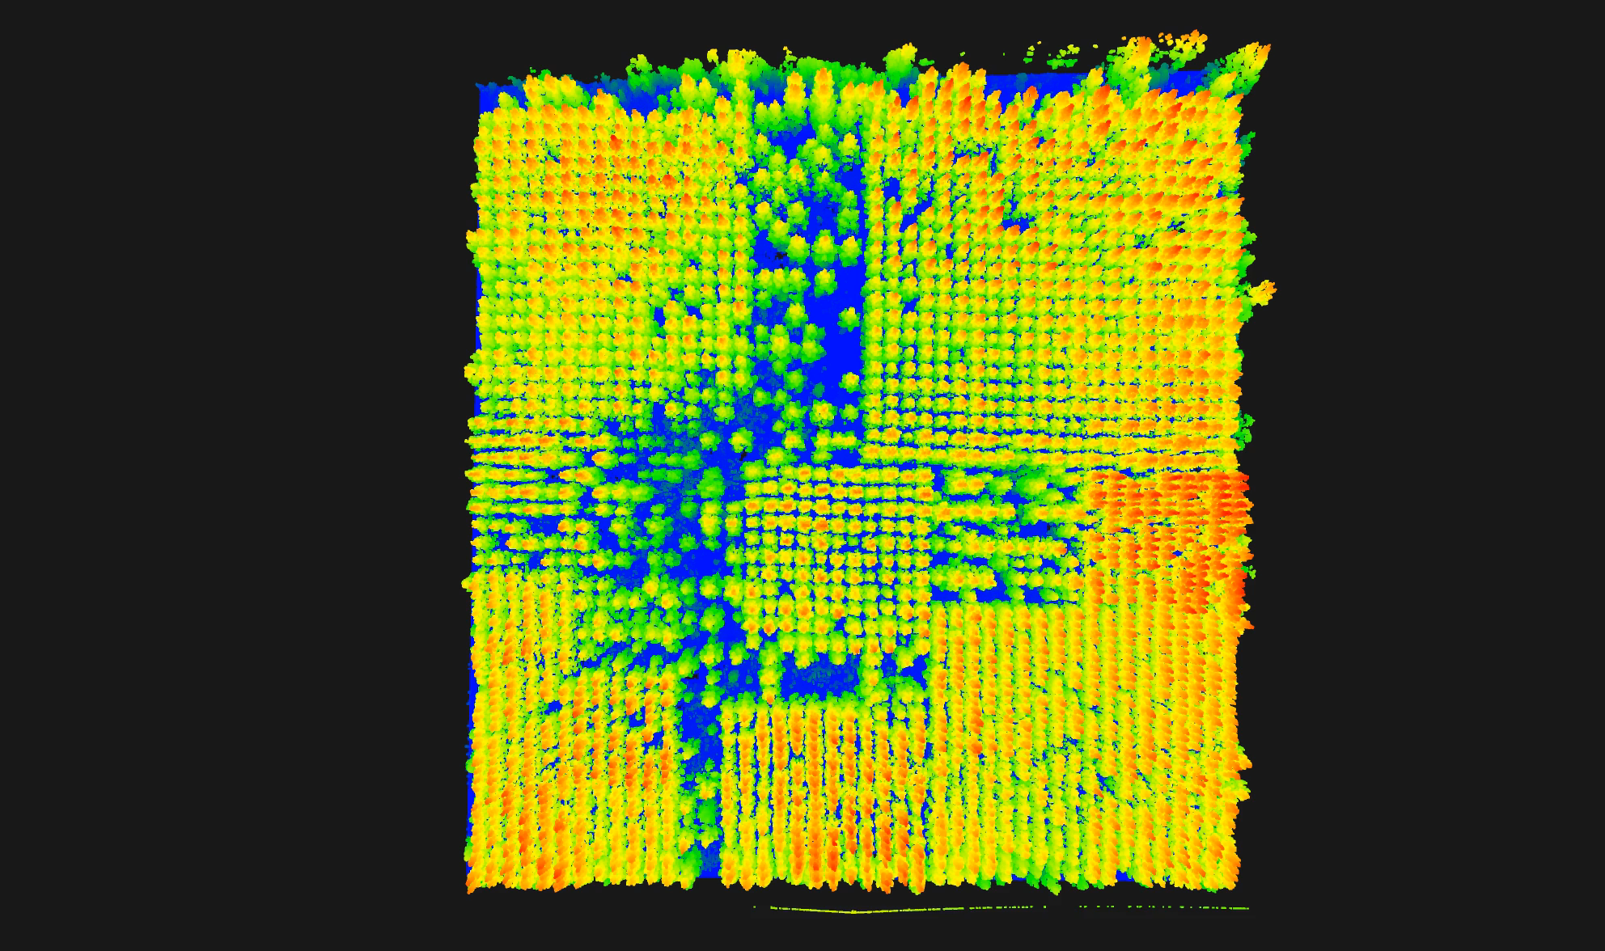

Slide 3
Workflow
Objective: Demonstrate viability of high-throughput phenotyping for traits observable from aerial POV, namely height and crown area for individual trees
Lidar data collection
Classifying ground points (LASTools)
Normalizing terrain (LASTools)
Semi-automated ITD (R)
Analysis of traits w/r/t genotypes & spacing

Slide 4
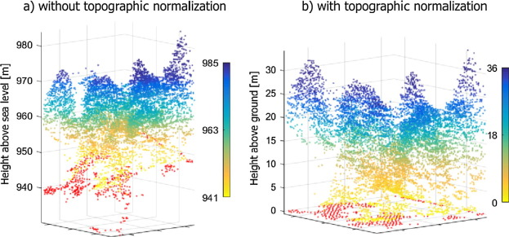
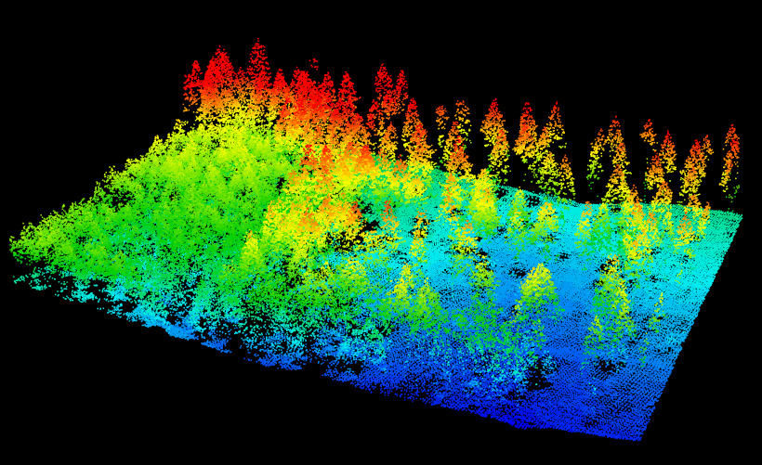
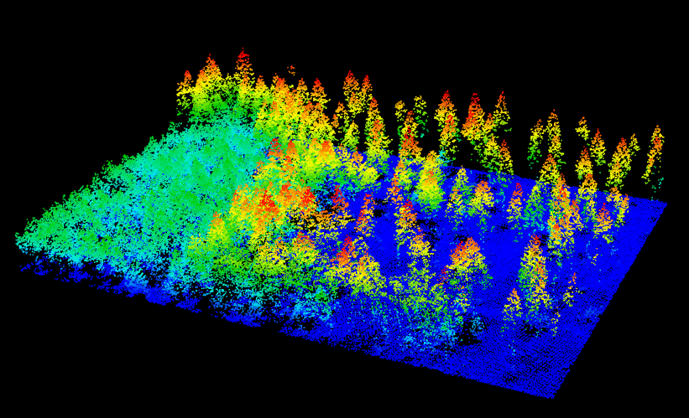
Classifying & normalizing ground
Point cloud processing software is used to classify points as either ground or non-ground returns.
The point cloud then normalizes, or flattens, the terrain, so that the heights of the features in the point cloud are represented by their heights above ground.

Slide 5
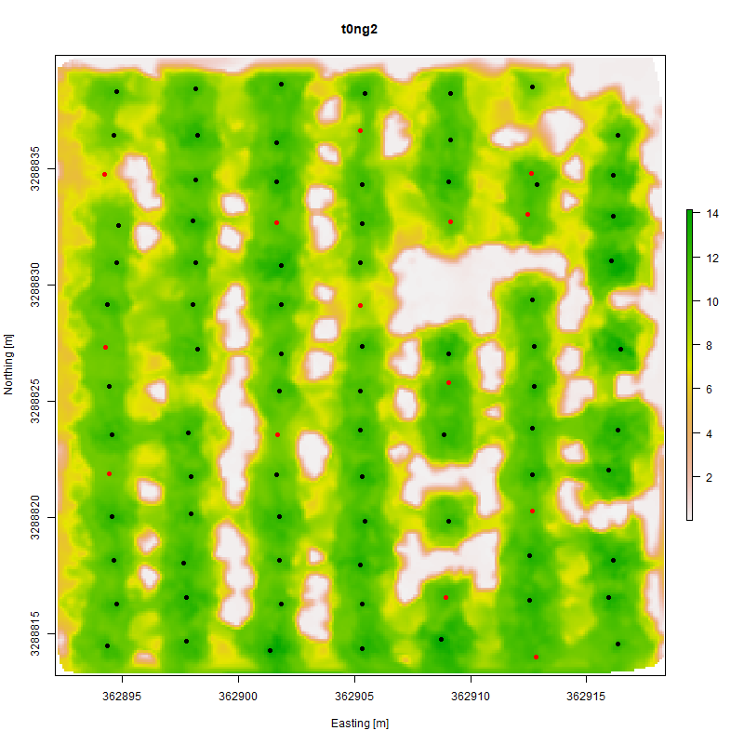
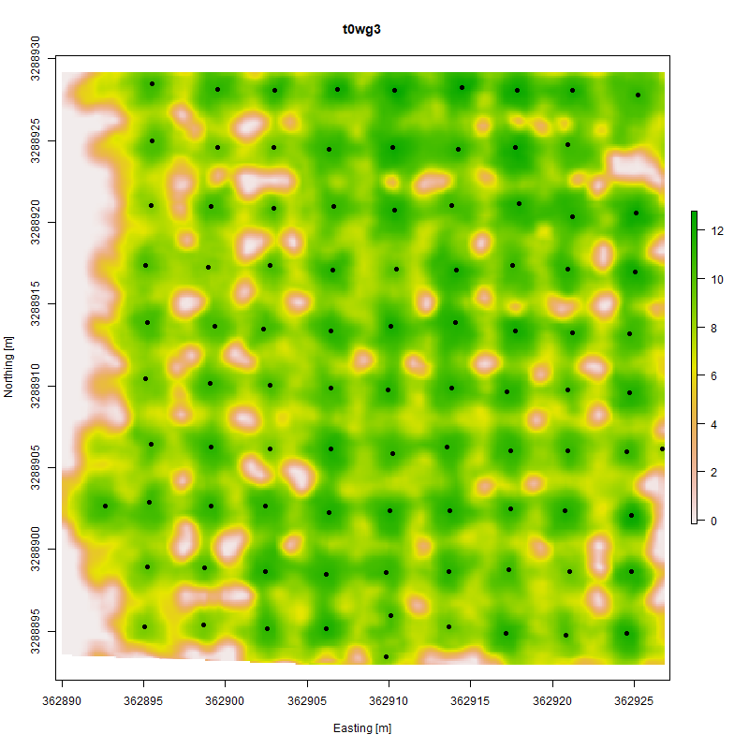
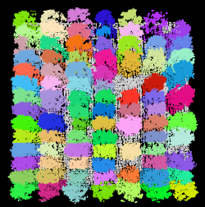
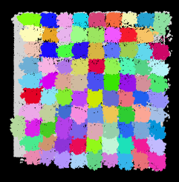
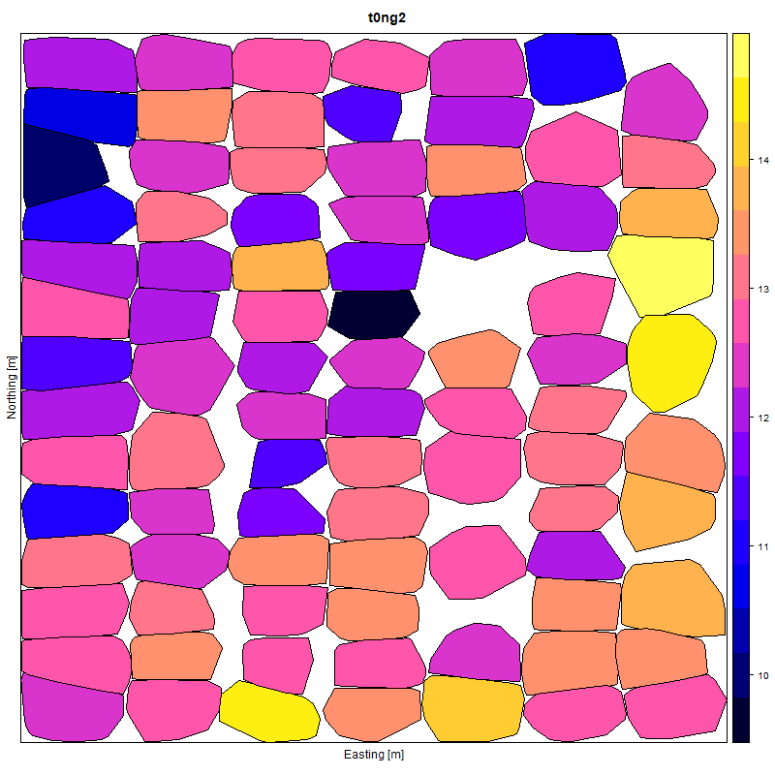
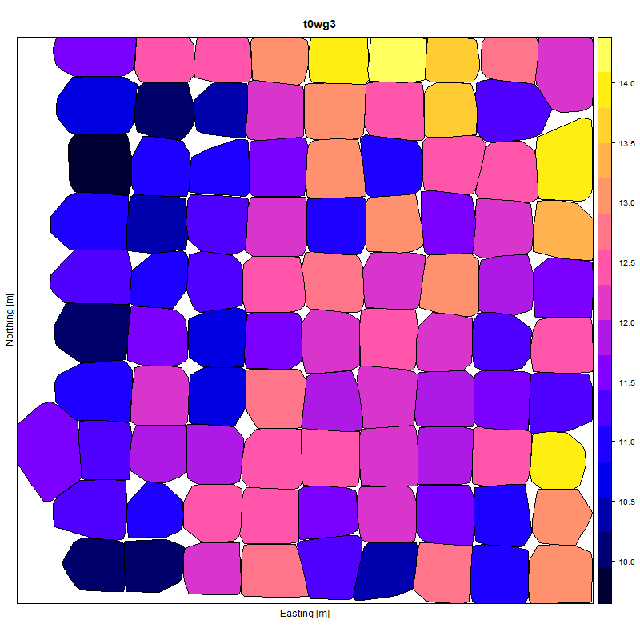
Narrow (6’ x 12’)
Wide (12’ x 12’)
Individual tree detection (ITD) and trait extraction
CW from top left:
Treetop detection
(manual edits = red)
Crown segmentation
and convex hull fitting

Slide 6
Sorting algorithm
Detected treetops sorted by an algorithm I designed for row planting
Allows for quick verification of detected trees

Slide 7
Height and crown area results
Neighbored trees of three genotypes (red, green, blue) with 95% error bars
P-value | Height | Crown Area
Narrow | <0.00001 | <0.00001
Wide | <0.00001 | <0.00001

Slide 8
Height comparison

Slide 9
GatorEye lidar ground classification
University of Florida · IMPAC II · Gainesville
H. Andrew Lassiter · Eben Broadbent · Jason Vogel · Gary Peter
Data collected: November 2018

Slide 10
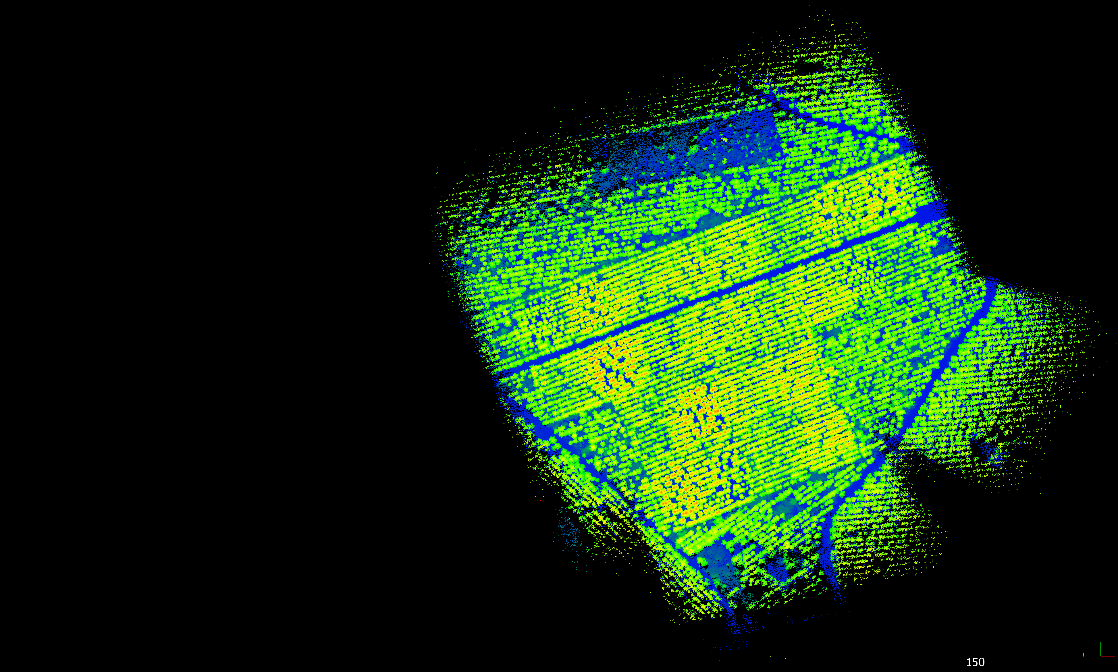
Accurate ground classification is essential to CHM generation and automated or semi-automated determination of tree height.
IMPAC II is a double-bed pine stand with 12’ row spacing. Ground elevation can vary up to 2’ over 4-6’ distance between rows. How does ground classification handle these variations?
GatorEye: Velodyne VLP-16
collected 21 Nov 2018
40 m AGL • 6 m/s 20 m flightline spacing 350 pts·m⁻¹ (thinned to 40 pts·m⁻¹)

Slide 11
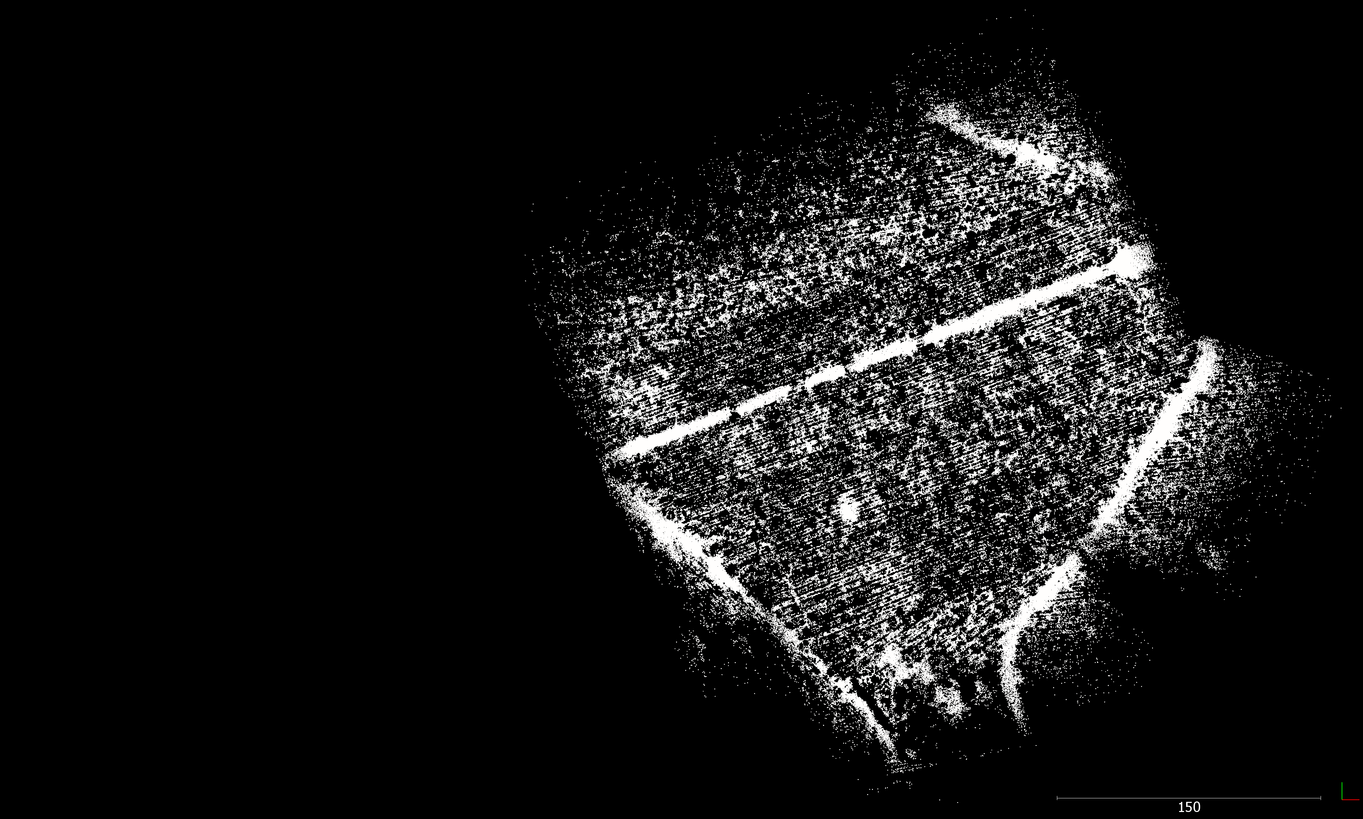
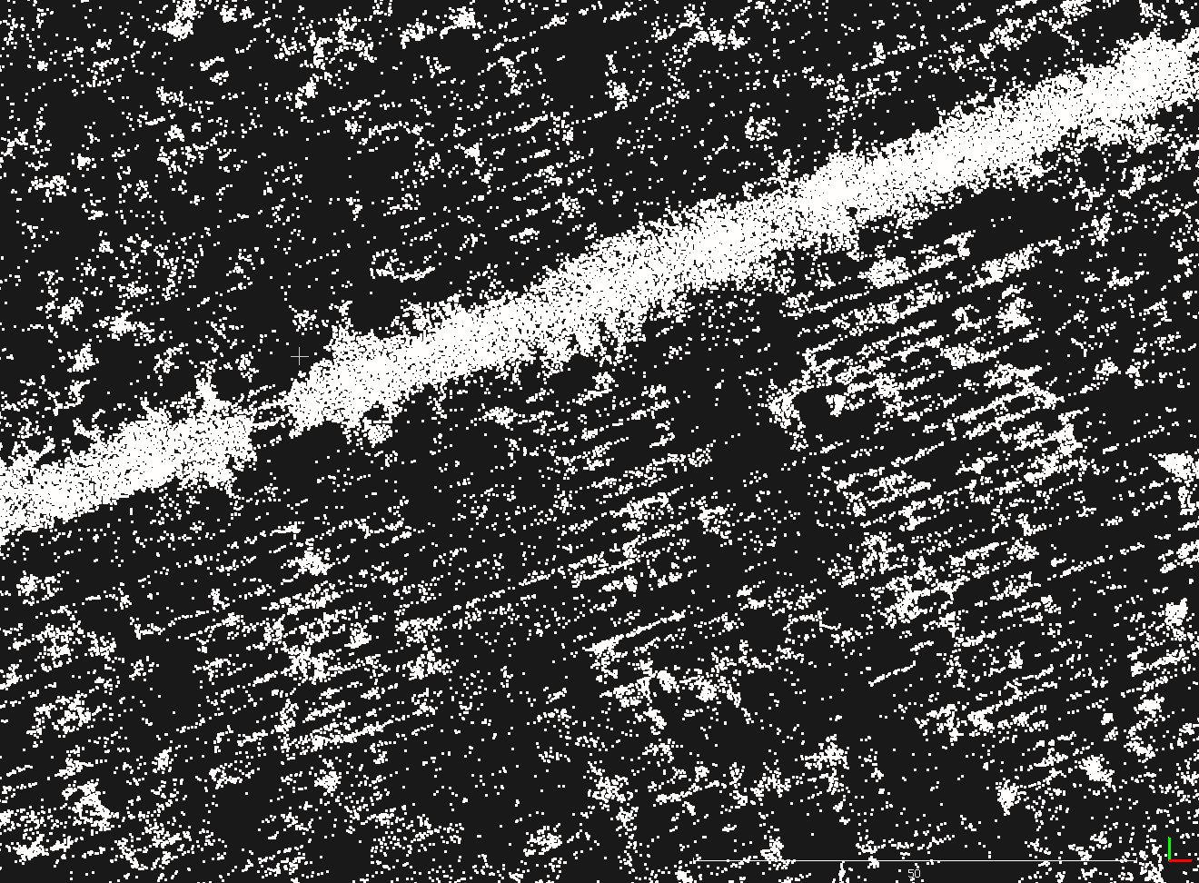
Only ground points shown (default settings, LASTools). Notice the solid appearance of the roads versus the visible lines of the pine stand. Not all ground points are being classified (but they are being detected).

Slide 12
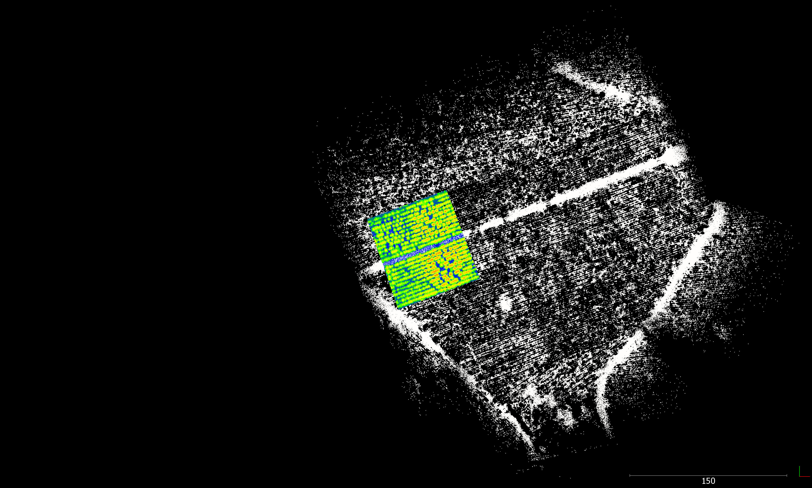
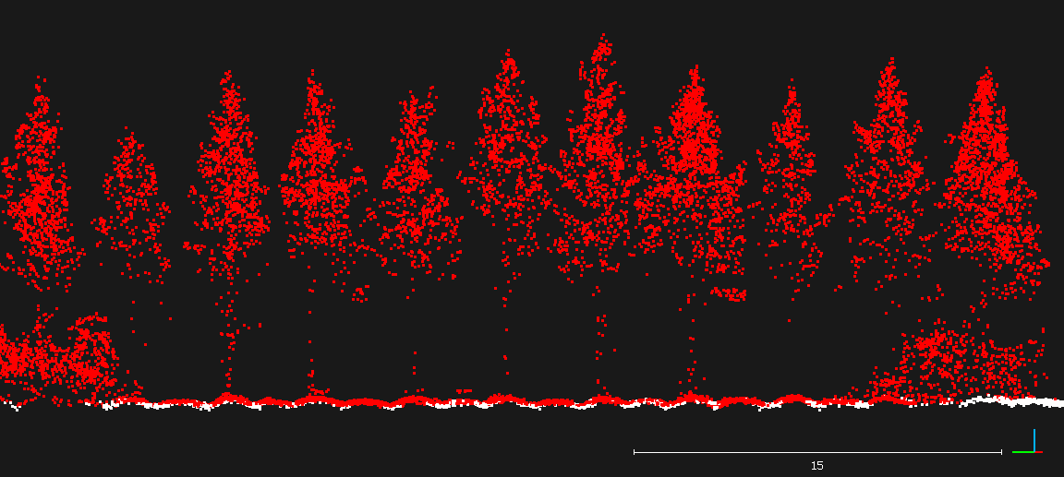
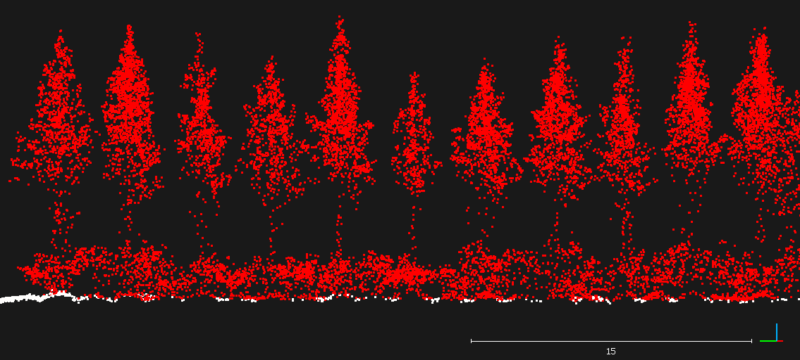
Objective: Investigage LASTools ground classification algorithm’s ability to adequately classify ground returns in bedded planting under understory control and no understory control conditions.

Slide 13
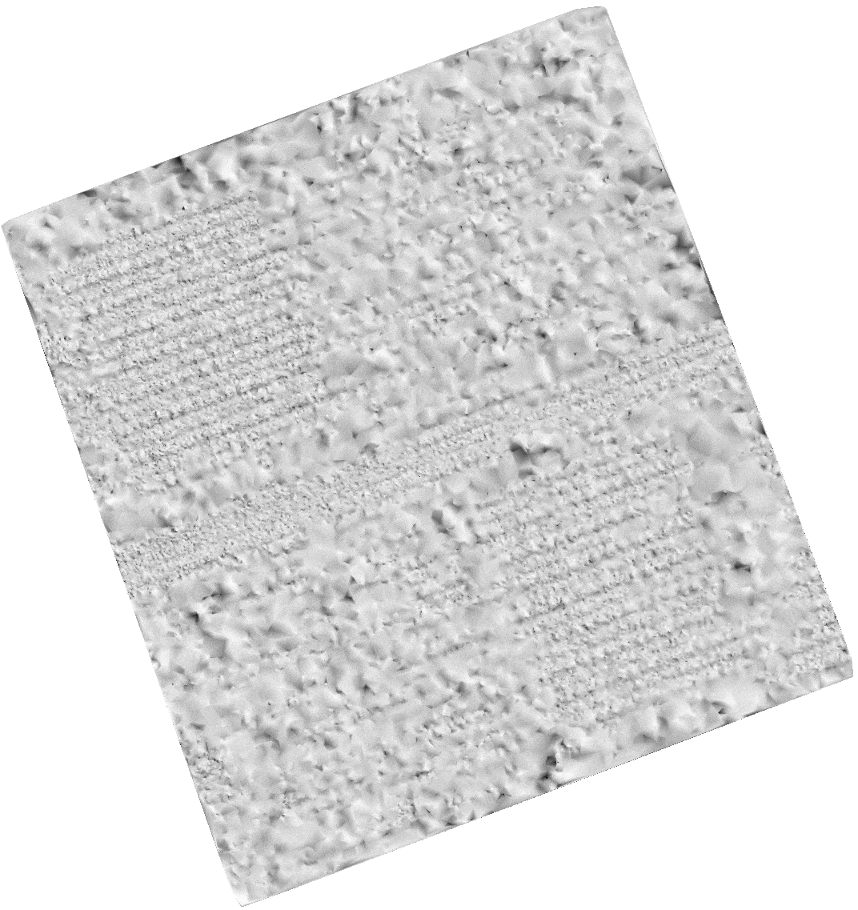
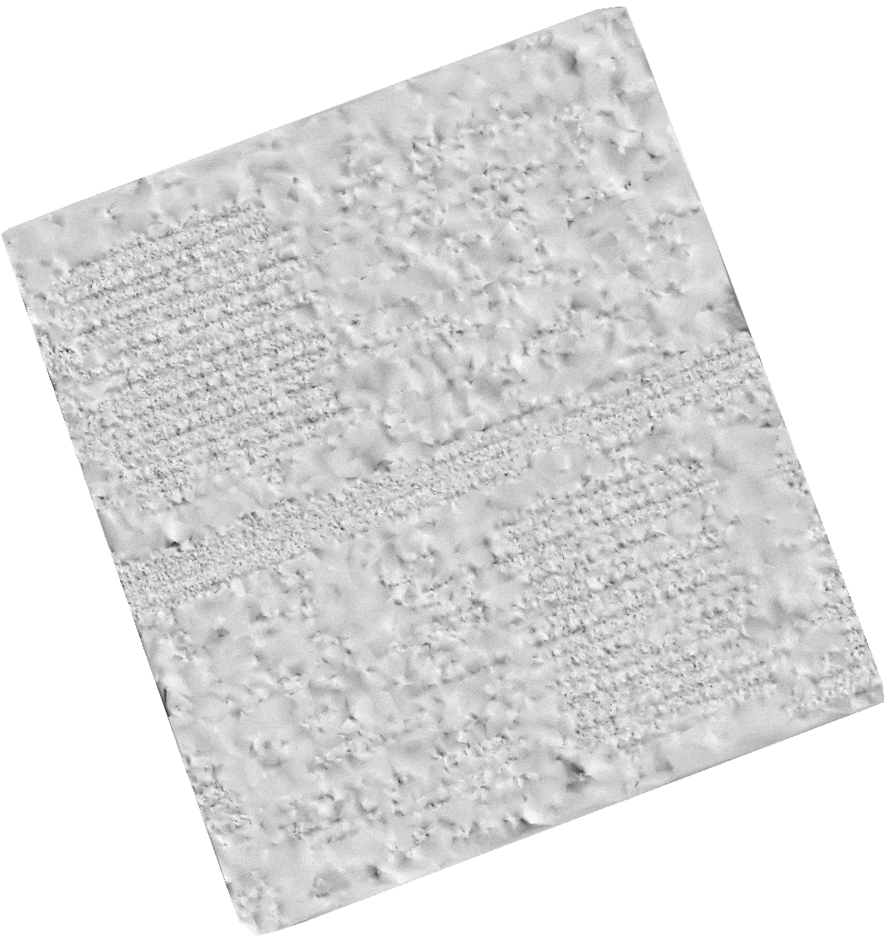
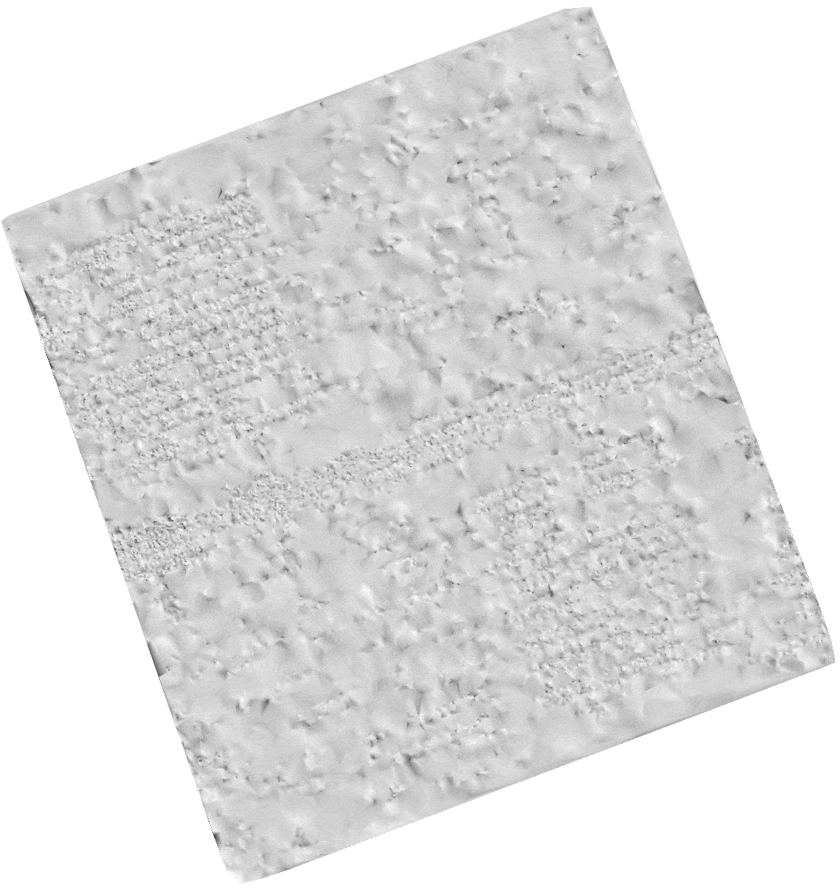
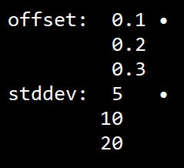
Ground classification inspection
Qualitative inspection of ground classification using hillshade DEM. Looking for a few candidates to investigate more thoroughly.
step 1
step 2
step 5

Slide 14
Understory control
white: class 2 ground
red: class 1 nonground lasground, default settings
scale in meters

Slide 15
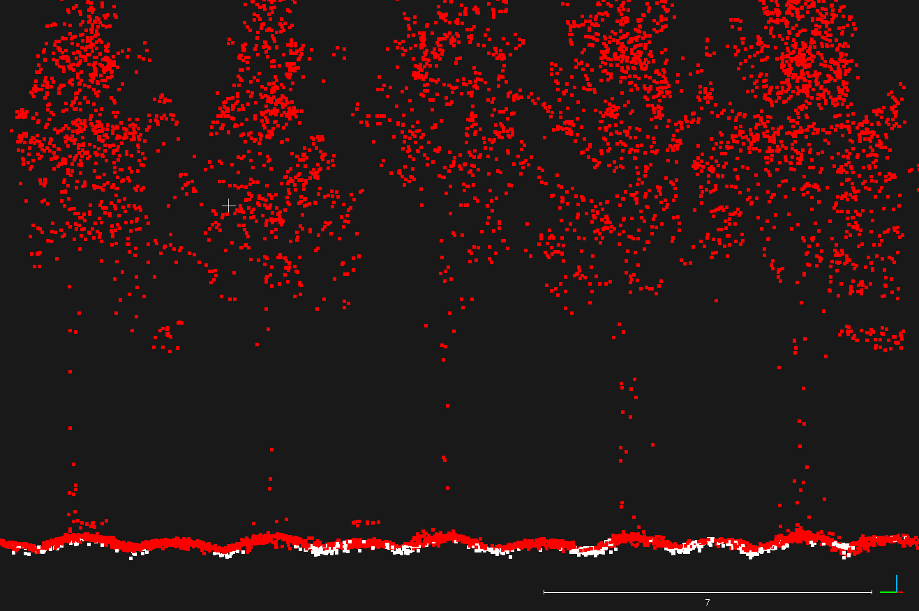
Understory control
Close-up of profile along study plot

Slide 16
No understory control

Slide 17
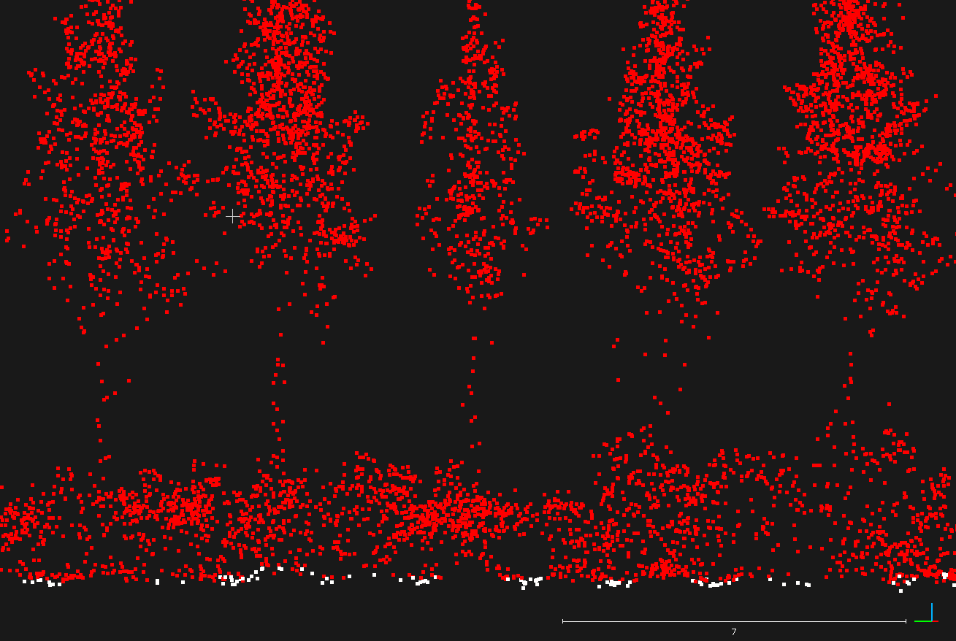
No understory control

Slide 18
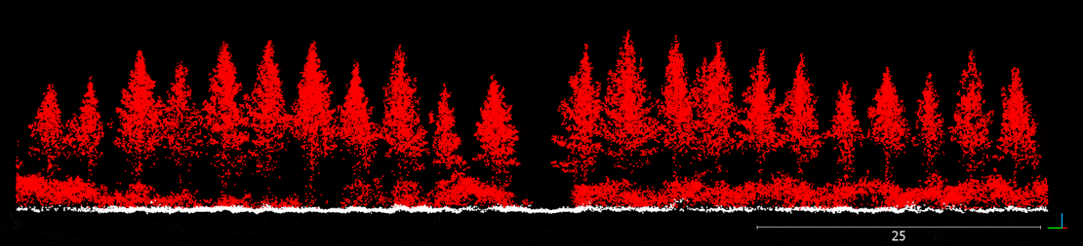
Winner: step 5m, offset 0.2m, stddev 5cm
White = classified ground. These settings appear to minimize both Type I and Type II error.

Slide 19
FARO Focus S 350 demo
University of Florida · VARIETIES II · Millhopper
Presentation prepared by H. Andrew Lassiter (UF)
Data provided by Andrew Siegler (FARO)
Data collected: February 2019

Slide 20
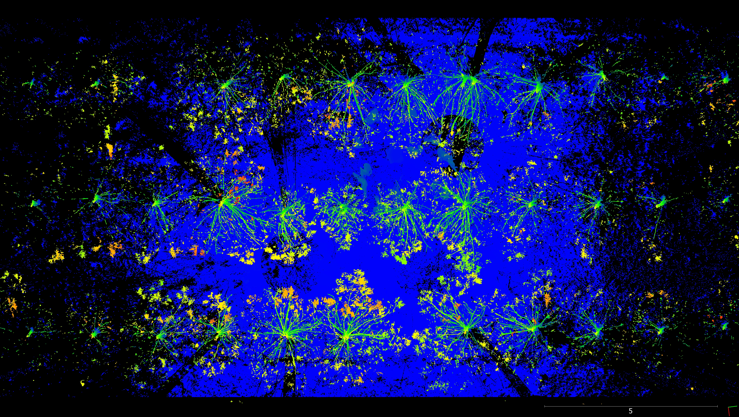
slice 1
station
slice 2
station
station
slice 3
Three slices along rows near collection site selected for inspection.

Slide 21
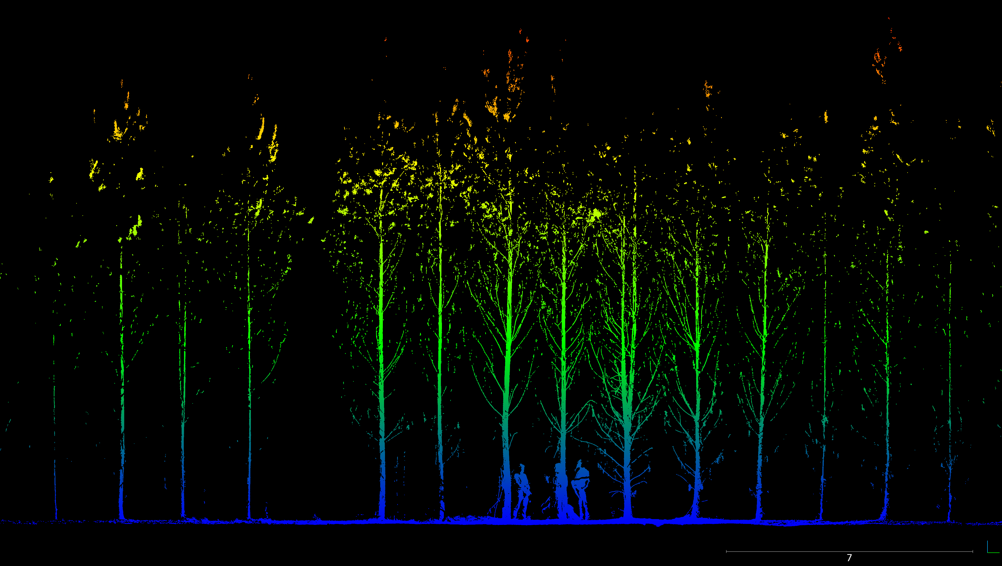
slice 1

Slide 22
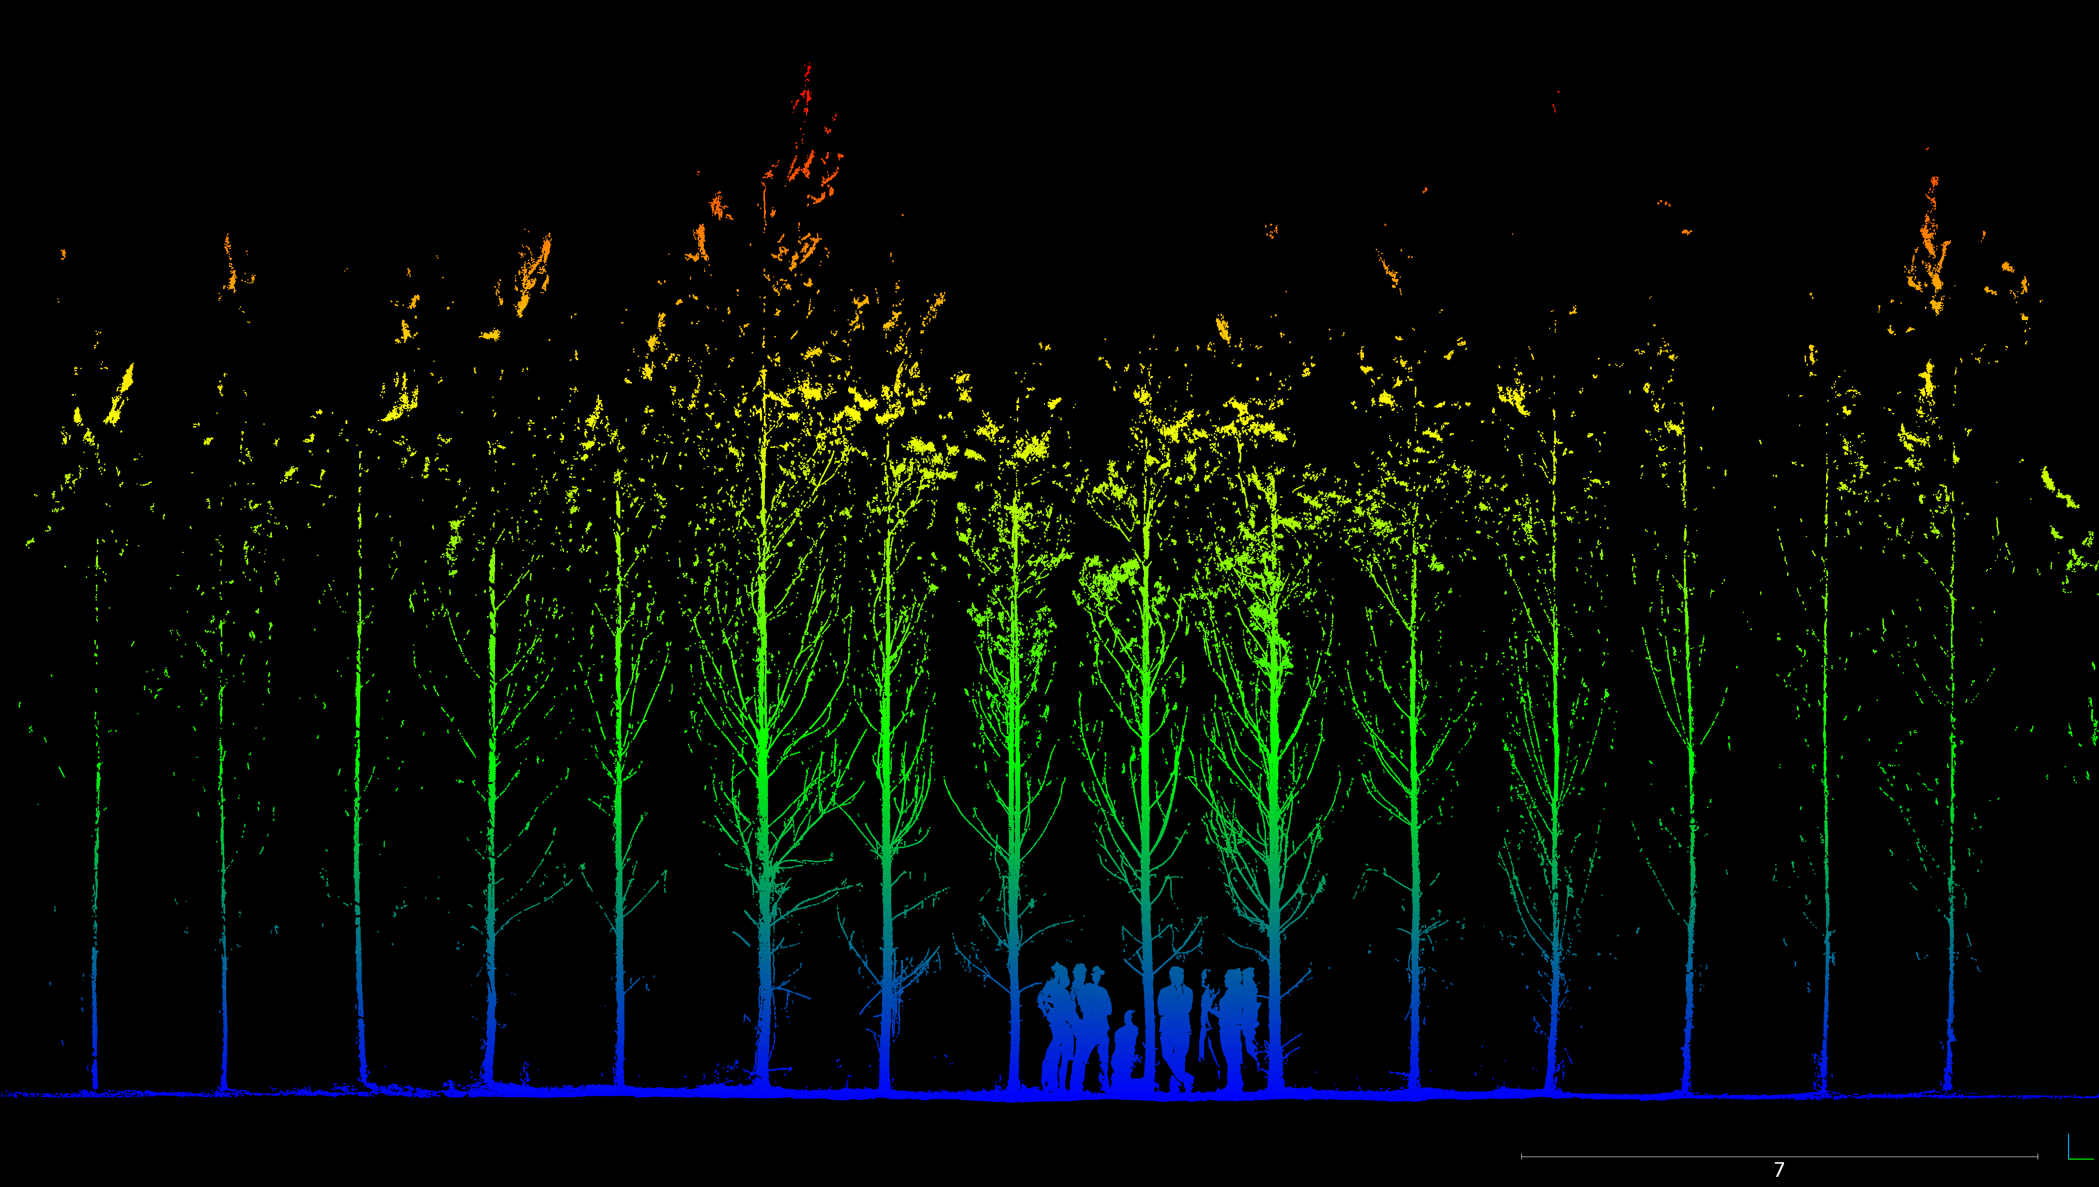
slice 2

Slide 23
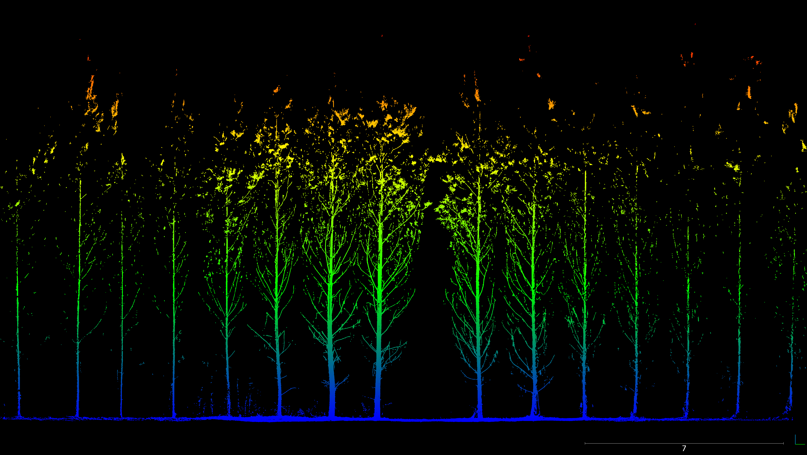
slice 3

Slide 24
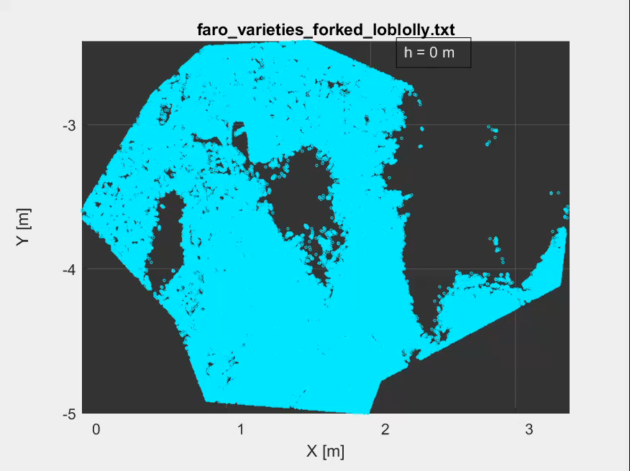
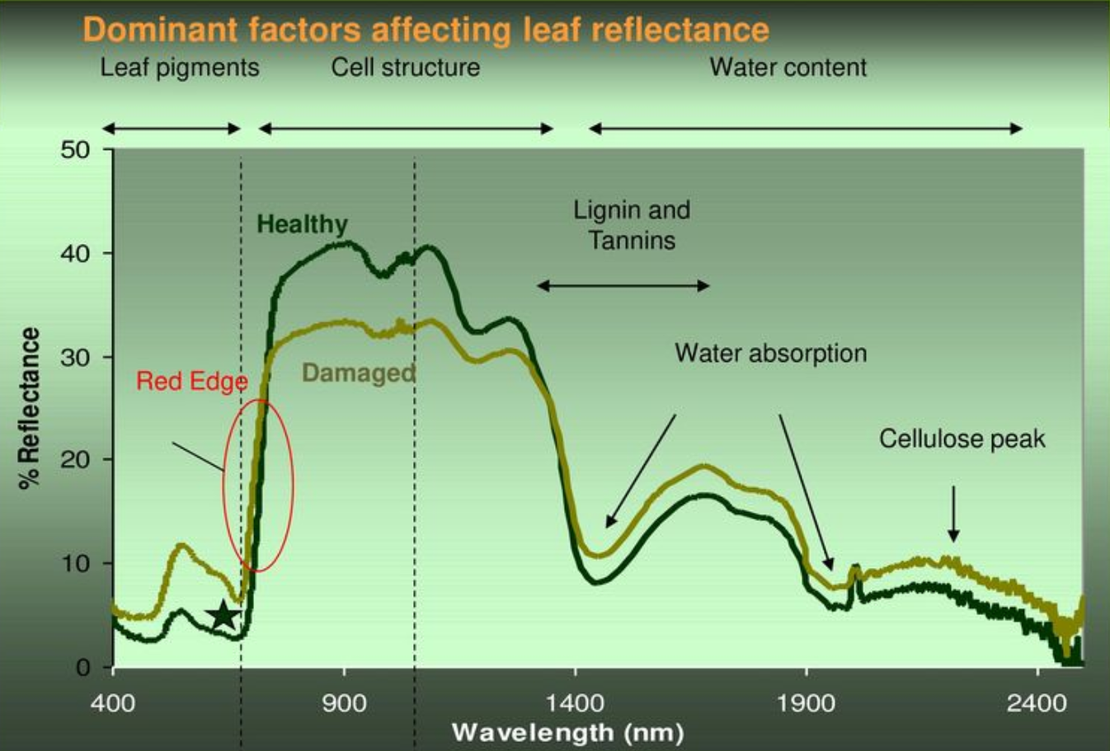
MRI-style vertical inspection of a single, forked stem (video):
Based on this video and the previous images, it appears the pine needles are not producing many returns.
Possible causes?
wavelength (1550 nm)
return discriminator
White pine needle reflectance (UNH Forest Watch)

